Slide 1
Youth Modules 1 to 3
A brief look at the English FA’s Youth Modules, with example sessions for the Youth Module 3
By Coach Helen Lorraine Nkwocha

Slide 2
I Need to Understand My Players
The Player Who is the ‘Beginner’: Usually the youngest players. We recognise these players by their technique and how they move.
The ‘Intermediate’ Player: This is the grey area between beginner and advanced. Now, the player is gaining improved memory. They are more consistent, self-correct and they focus less on the ball.
‘Individuality’: This is the player who puts their own ‘stamp’ on what they do once they have gained experience.
‘Experts’: This is the player who does things automatically with a vast football memory. Seeing things quickly.
‘Talented’: There are many talented players who are not playing in academies. They tend to display positive traits, but without consistency. Environment will support these players.

Slide 3
The 4 Corner Model
Players should be given game-related practices to support their understanding of the game and this will help me understand my players.
Physical Corner: Developing fundamental (movements which involve different body parts) to complex motor skills (ie: movement of limbs where one part performs a difficult task and the other performs an easier task)
Mental Corner: Leadership skills, independent problem solving, will negotiate and compromise with peers, longer concentration span, easily motivated
Social Corner: Positive acceptance of others, enjoys group activities, moves away from reliance on family, hormones could cause mood swings, females may be more socially mature than males
Technical Corner: Excellent handling skills, reads the game well & positions themselves effectively, has the composure to pass & receive with both feet, challenges decisively & fairly
The 4 Corner Model is Age Specific

Slide 4
Youth Module 1
Developing the Environment
Design practices where players are challenged physically (running, changing pace, changing direction, etc).
Make adjustments according to the players’ ability
Give the players different ways to achieve the same outcome
Provide feedback which supports development

Slide 5
Youth Module 2
Developing the Practice
How we develop the practice is supported by Long Term Player Development (LTPD).
LTPD allows us to recognise the individual needs of our players and meet those needs through the design of our sessions.
To develop the appropriate practice, we need to understand the mechanics of the player and elements which effect them.

Slide 6
Youth Module 3
Developing the Player
My Example Practice

Slide 7
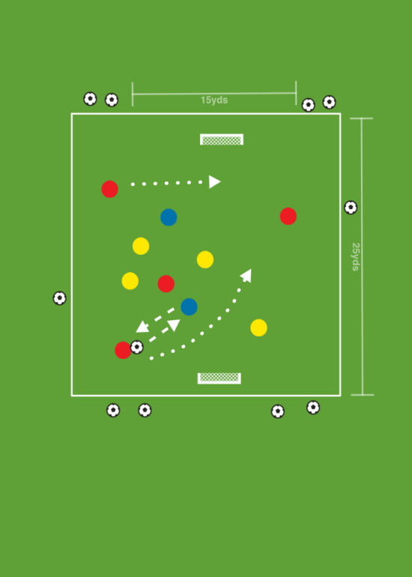
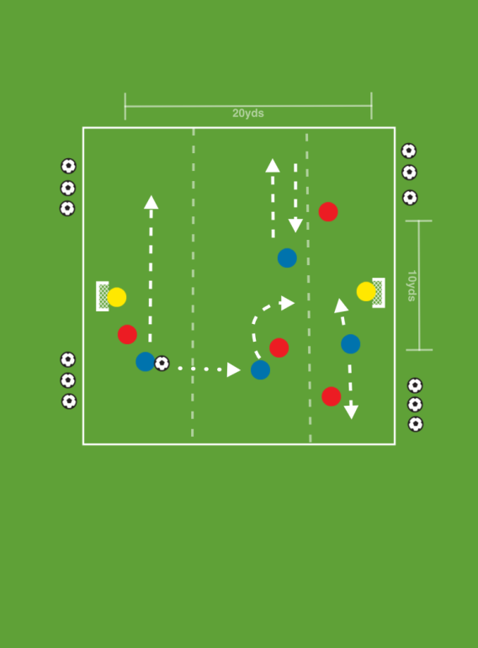
Turning
The ‘Whole, Part Whole’ Approach’
Whole Practice
Part Practice
Whole Practice

Slide 8

The Set-Up
Time | Set-Up | Increase Difficulty | Reduce Difficulty | Learning Points
15 minutes | Field divided into thirds. Players matched up evenly. Cannot travel out of their third. Players in possession must look for opportunities to turn successfully. | Must complete a turn before taking a shot on goal. Must complete turn within 5 seconds | Larger area. Introduce passive defending | Keep the ball close use a variety of surfaces of the ball and your foot get upper body lower to the ground to help shield the ball.

Slide 9
Providing Challenges
Challenges Relating to the Coaching Topic | Challenges Relating to the Individual Player
Try to recognise when you should Turn and when you should not Turn | Try to shield / protect the ball if you cannot Turn
Try to recognise where you should Turn and when you should not Turn | Try to receive the ball with the foot which is further away from the oncoming defender
Try to sneak a look at the defender behind you just before you receive the ball | Try to pass to feet

Slide 10
My Tips
Problem Solving: Give players an opportunity to work together to solve game-related issues. I almost always introduce a ‘half time’.
Position Appreciation: Consider playing players in a variety of positions.
Learning Through Mistakes: Allow players to take risks and learn through mistakes. I tend to provide a mixture of public and private praise when this occurs. But, if the mistake is regular, I consider stepping in to coach or taking the player aside to re-enforce how we would reduce the mistake reoccurring.
Learning Through Games: I am trying more an more to increase the variety of games which I deliver. But, I have to monitor the quality, just to ensure we aren’t playing games for the sake of playing games. The learning outcomes need to be a priority.
www.ImmersedintheGame.org

