Slide 1
“Be Immersed in the Game”
This is my coaching philosophy

Slide 2

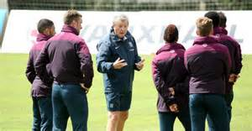
An Explanation of my Philosophy
My philosophy, ‘Be Immersed in the Game’, relates more to the mentality that I would like players to have. I believe that if a player can adopt an attitude which demonstrates a consistent commitment to learning and developing, then the detail needed to improve their technical and tactical performance will come. This is reliant upon other factors, such as opportunities to play and practice and playing at the appropriate level.

Slide 3
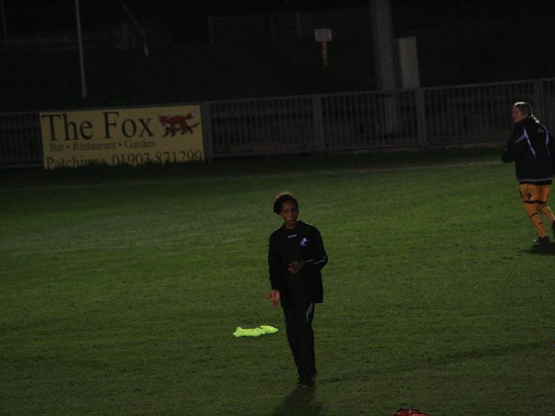
“I am still developing my coaching philosophy...”
My coaching philosophy is still developing as I learn more about the game. However, I do have an expectation that physically, players should have high levels of fitness, and demonstrate a commitment to improving their athleticism. Here is my coaching philosophy at this stage of my career...

Slide 4
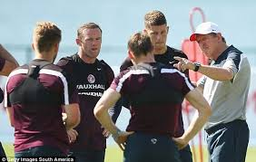
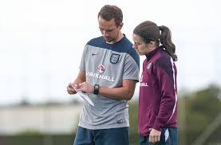
‘Be Immersed in the Game’
Regardless of ability or experience....
Embrace the game and all that it teaches.

Slide 5

The Team needs to have a determination to do well and work hard for each other

Slide 6
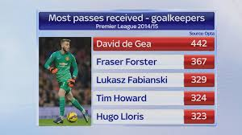
Goalkeepers
Goalkeepers should be competent with their feet as well as their hands....
...they should recognise transitions within the game with a view to managing their defence effectively.

Slide 7

Defenders
Defenders should have good concentration. They should also be brave aerially and in their attempts to reduce shots on goal. They should also be direct in their play. Recognising when to 'Play Out from the Back‘ and through the thirds of the field, and when to play direct.

Slide 8


Midfielders
Midfielders, including wingers, should strive to be technically superb and tactically aware
They should look to dominate opposition and dictate our team shape with varied passing and physique

Slide 9
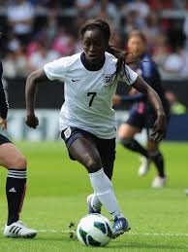
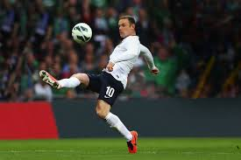
Strikers
Strikers should be over-confident with respect to their obligation to create and take opportunities in front of the goal. They should also have an understanding that they need to 'defend from the front’

Slide 10
“Be Immersed in the Game”
This is my coaching philosophy,
Coach Helen L. Nkwocha

